Slide 1

IOT AND CLOUD COMPUTING
By,
Ass. Prof. Kunal D Gaikwad
Pursuing PHD (IOT and Machine Learning)
M.E(Computer Networks)
B.E(Computer Science & Engineering)
Diploma(Computer Engineering)
Ass. Prof. Kunal D Gaikwad
CSE Department, CMRIT

Slide 2
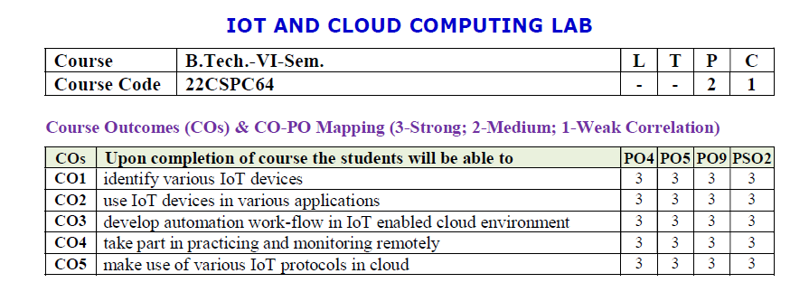
Ass. Prof. Kunal D Gaikwad
CSE Department, CMRIT

Slide 3
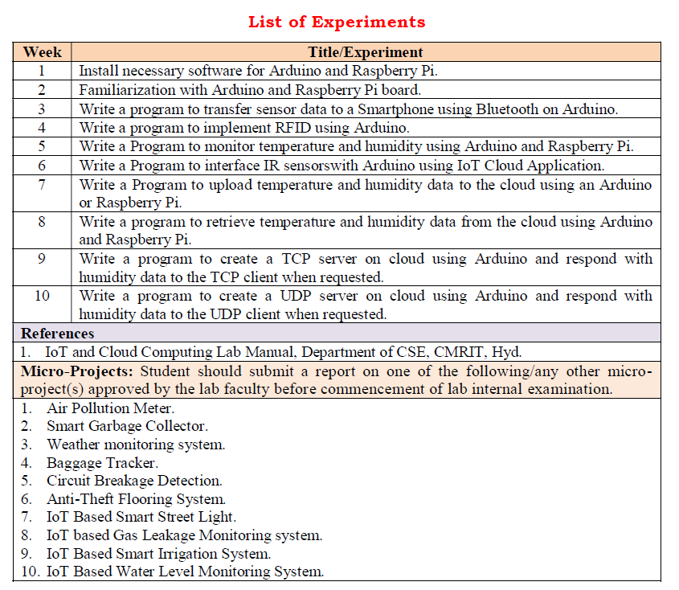
Ass. Prof. Kunal D Gaikwad
CSE Department, CMRIT

Slide 4
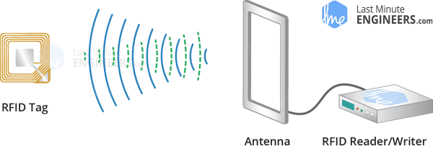
WEEK 4
AIM: Write a program to implement RFID using Arduino.
What is RFID technology and how does it work?
An RFID or radio frequency identification system consists of two main components, a tag attached to the object to be identified, and a reader that reads the tag.
A reader consists of a radio frequency module and an antenna that generates a high frequency electromagnetic field. Whereas the tag is usually a passive device (it does not have a battery). It consists of a microchip that stores and processes information, and an antenna for receiving and transmitting a signal.
When the tag is brought close to the reader, the reader generates an electromagnetic field. This causes electrons to move through the tag’s antenna and subsequently powers the chip.
Ass. Prof. Kunal D Gaikwad
CSE Department, CMRIT

Slide 5
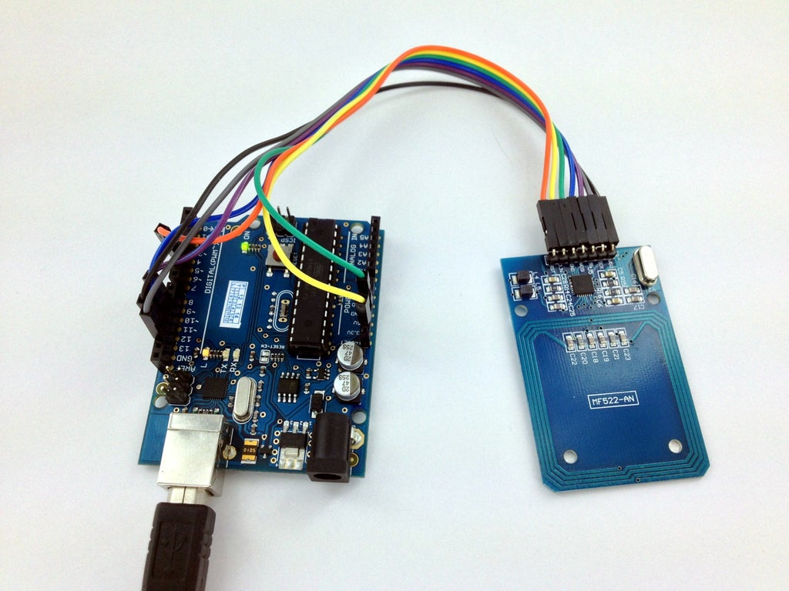
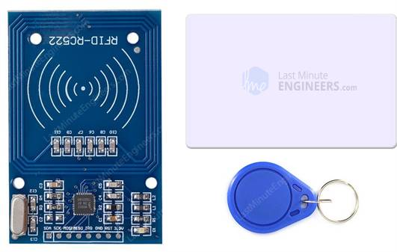
Hardware Overview
The RC522 RFID module based on the MFRC522 IC is one of the cheapest RFID options you can get online for less than four dollars. It usually comes with an RFID card tag and a key fob tag with 1KB of memory. And the best part is that it can write a tag that means you can store any message in it.
The RC522 RFID reader module is designed to create a 13.56MHz electromagnetic field and communicate with RFID tags (ISO 14443A standard tags).
The reader can communicate with a microcontroller over a 4-pin SPI with a maximum data rate of 10 Mbps. It also supports communication over I2C and UART protocols.
The RC522 RFID module can be programmed to generate an interrupt, allowing the module to alert us when a tag approaches it, instead of constantly asking the module “Is there a card nearby?”.
The module’s operating voltage ranges from 2.5 to 3.3V, but the good news is that the logic pins are 5-volt tolerant, so we can easily connect it to an Arduino or any 5V logic microcontroller without using a logic level converter.
Ass. Prof. Kunal D Gaikwad
CSE Department, CMRIT

Slide 6
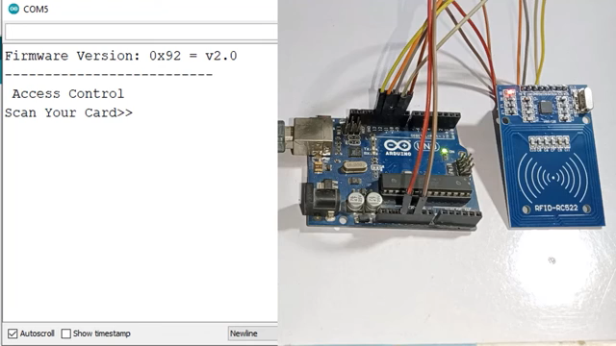
Sample Video
Ass. Prof. Kunal D Gaikwad
CSE Department, CMRIT

Slide 7
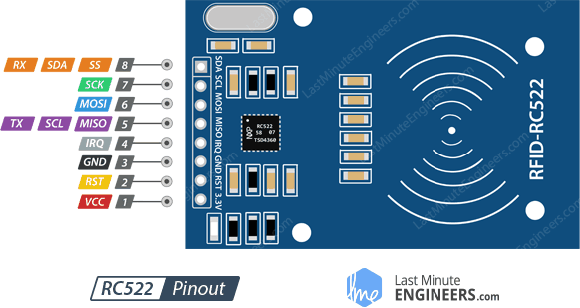
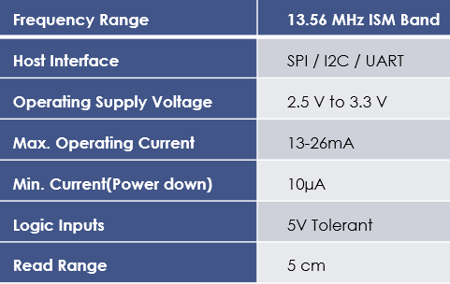
The RC522 module has a total of 8 pins that connect it to the outside world. The connections are as follows:
Technical Specifications
Ass. Prof. Kunal D Gaikwad
CSE Department, CMRIT

Slide 8
VCC supplies power to the module. This can be anywhere from 2.5 to 3.3 volts. You can connect it to the 3.3V output from your Arduino. But remember that connecting it to the 5V pin will probably destroy your module!
RST is an input for reset and power-down. When this pin goes low the module enters power-down mode. In which the oscillator is turned off and the input pins are disconnected from the outside world. Whereas the module is reset on the rising edge of the signal.
GND is the ground pin and needs to be connected to the GND pin on the Arduino.
IRQ is an interrupt pin that alerts the microcontroller when an RFID tag is in the vicinity.
Ass. Prof. Kunal D Gaikwad
CSE Department, CMRIT

Slide 9
MISO / SCL / Tx pin acts as master-in-slave-out when SPI interface is enabled, as serial clock when I2C interface is enabled and as serial data output when the UART interface is enabled.
MOSI (Master Out Slave In) is the SPI input to the RC522 module.
SCK (Serial Clock) accepts the clock pulses provided by the SPI bus master i.e. Arduino.
SS / SDA / Rx pin acts as a signal input when the SPI interface is enabled, as serial data when the I2C interface is enabled and as a serial data input when the UART interface is enabled. This pin is usually marked by encasing the pin in a square so that it can be used as a reference to identify other pins.
Ass. Prof. Kunal D Gaikwad
CSE Department, CMRIT

Slide 10
First connect the VCC pin on the module to 3.3V and the GND pin to ground on the Arduino. Pin RST can be connected to any digital pin on the Arduino. In our case, it is connected to digital pin #5. The IRQ pin is left unconnected because the Arduino library we are going to use does not support it.
Now we are left with the pins that are used for SPI communication. Since RC522 modules require a lot of data transfer, they will give the best performance when connected to the hardware SPI pins on the microcontroller.
Note that each Arduino board has different SPI pins that must be connected accordingly. Check the table below for quick understanding.
 | MOSI | MISO | SCK | CS
Arduino Uno | 11 | 12 | 13 | 10
Arduino Nano | 11 | 12 | 13 | 10
Arduino Mega | 51 | 50 | 52 | 53
Ass. Prof. Kunal D Gaikwad
CSE Department, CMRIT

Slide 11
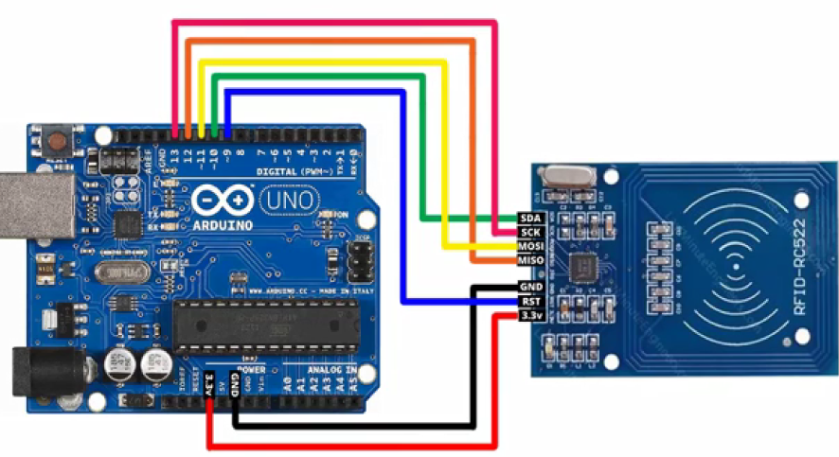
Wiring RC522 RFID Reader Writer Module with Arduino UNO
Once you have connected everything you are ready to go!
Ass. Prof. Kunal D Gaikwad
CSE Department, CMRIT

Slide 12
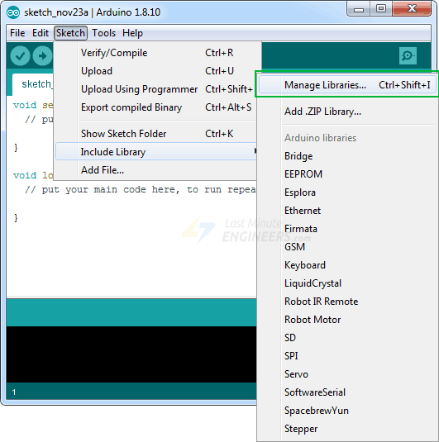
Library Installation
Communicating with an RC522 RFID module is a lot of work, but luckily for us there is a library called the MFRC522 library that makes reading and writing RFID tags simple.
This library is not included in the Arduino IDE, so you will need to install it first.
To install the library navigate to Sketch > Include Libraries > Manage Libraries… Wait for Library Manager to download the library index and update the list of installed libraries.
Ass. Prof. Kunal D Gaikwad
CSE Department, CMRIT

Slide 13
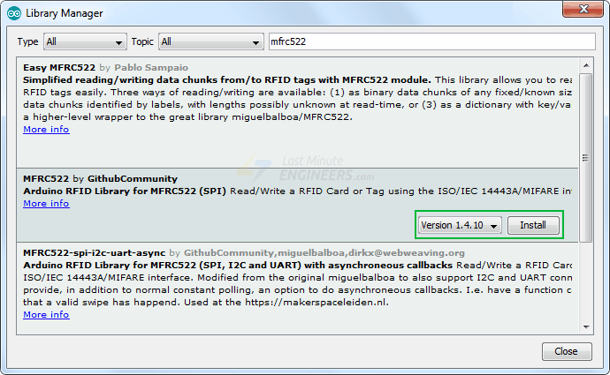
Filter your search by typing ‘mfrc522‘. Look for the library by GithubCommunity. Click on that entry, and then select Install.
Ass. Prof. Kunal D Gaikwad
CSE Department, CMRIT

Slide 14
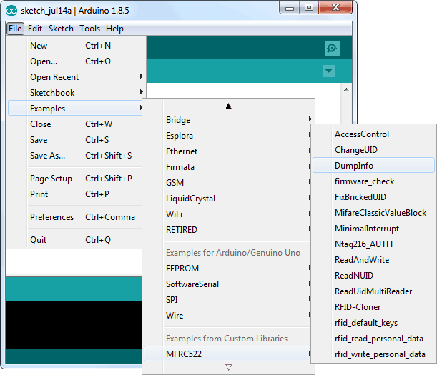
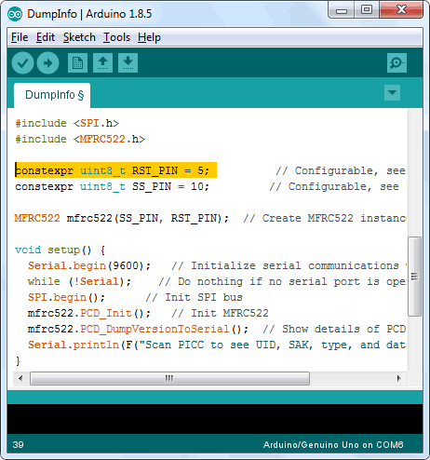
Arduino Code – Reading an RFID Tag
Once you have installed the library, open the Examples submenu and choose MFRC522 > DumpInfo example sketch.
This sketch just reads the tag and displays the information stored in it. This sketch can be very handy before trying out any new tags!
Go to the beginning of the sketch and make sure RST_PIN is initialized correctly, in our case we are using digital pin #5 so change it to 5
Ass. Prof. Kunal D Gaikwad
CSE Department, CMRIT

Slide 15
#include <SPI.h>
#include <MFRC522.h>
#define RST_PIN 9 // Configurable, see typical pin layout above
#define SS_PIN 10 // Configurable, see typical pin layout above
MFRC522 mfrc522(SS_PIN, RST_PIN); // Create MFRC522 instance
void setup() {
Serial.begin(9600); // Initialize serial communications with the PC
while (!Serial); // Do nothing if no serial port is opened (added for Arduinos based on ATMEGA32U4)
SPI.begin(); // Init SPI bus
mfrc522.PCD_Init(); // Init MFRC522
delay(4); // Optional delay. Some board do need more time after init to be ready, see Readme
mfrc522.PCD_DumpVersionToSerial(); // Show details of PCD - MFRC522 Card Reader details
Serial.println(F("Scan PICC to see UID, SAK, type, and data blocks..."));
Ass. Prof. Kunal D Gaikwad
CSE Department, CMRIT

Slide 16
}
void loop() {
// Reset the loop if no new card present on the sensor/reader. This saves the entire process when idle.
if ( ! mfrc522.PICC_IsNewCardPresent()) {
return;
}
// Select one of the cards
if ( ! mfrc522.PICC_ReadCardSerial()) {
return;
}
// Dump debug info about the card; PICC_HaltA() is automatically called
mfrc522.PICC_DumpToSerial(&(mfrc522.uid));
}
Now upload the sketch and open Serial Monitor. As you bring the tag closer to the module, you’ll get something like the following. Do not move the tag until all the information is displayed.

Slide 17
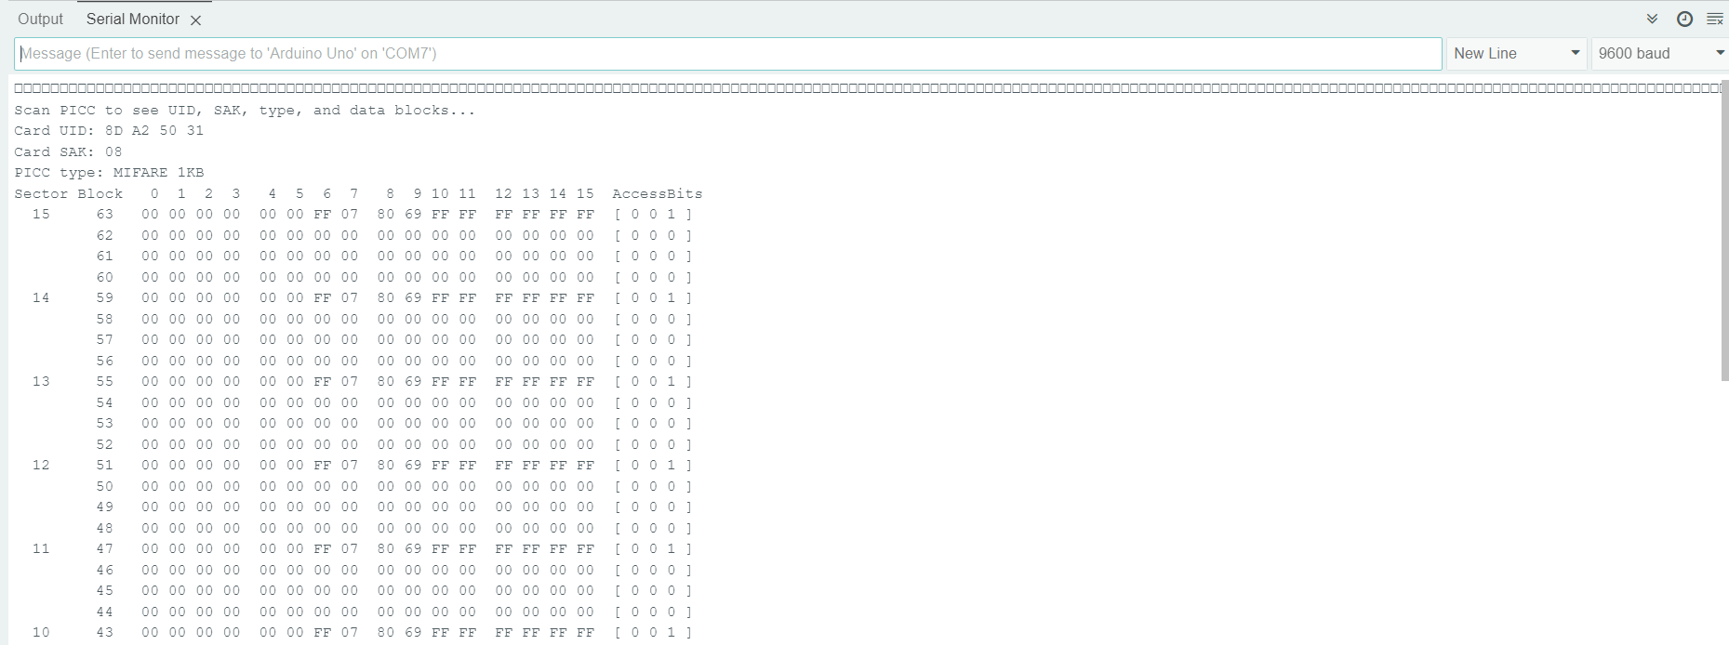
DUMP Information Program
Ass. Prof. Kunal D Gaikwad
CSE Department, CMRIT

Slide 18
READ Information Program
#include <SPI.h>
#include <MFRC522.h>
#define RST_PIN 9
#define SS_PIN 10
MFRC522 mfrc522(SS_PIN, RST_PIN);
void setup() {
Serial.begin(9600);
SPI.begin();
mfrc522.PCD_Init();
Serial.println(F("Read personal data"));
}
void loop() {
MFRC522::MIFARE_Key key;
for (byte i = 0; i < 6; i++)
key.keyByte[i] = 0xFF;
byte block;
byte len;
MFRC522::StatusCode status;
if ( ! mfrc522.PICC_IsNewCardPresent()) {
return;
}
if ( ! mfrc522.PICC_ReadCardSerial()) {
return;
}
Serial.println(F("**Card Detected:**"));
mfrc522.PICC_DumpDetailsToSerial(&(mfrc522.uid));
Serial.print(F("Name: "));
block = 4;
len = 18;
byte buffer2[18];
block = 1;
status = mfrc522.PCD_Authenticate(MFRC522::PICC_CMD_MF_AUTH_KEY_A, 1, &key, &(mfrc522.uid));
if (status != MFRC522::STATUS_OK) {
Serial.print(F("Authentication failed: "));
Serial.println(mfrc522.GetStatusCodeName(status));
return;
}
status = mfrc522.MIFARE_Read(block, buffer2, &len);
if (status != MFRC522::STATUS_OK) {
Serial.print(F("Reading failed: "));
Serial.println(mfrc522.GetStatusCodeName(status));
return;
}
for (uint8_t i = 0; i < 16; i++) {
Serial.write(buffer2[i]);
}
Serial.println(F("\n**End Reading**\n"));
delay(1000); //change value if you want to read cards faster
mfrc522.PICC_HaltA();
mfrc522.PCD_StopCrypto1();
}
Ass. Prof. Kunal D Gaikwad
CSE Department, CMRIT

Slide 19
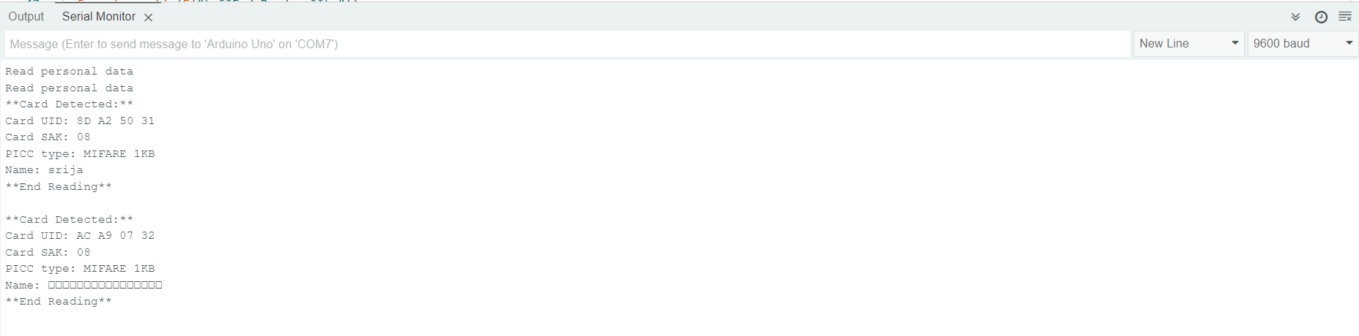
READ Information Program
Ass. Prof. Kunal D Gaikwad
CSE Department, CMRIT

Slide 20
#include <SPI.h>
#include <MFRC522.h>
#define RST_PIN 9
#define SS_PIN 10
MFRC522 mfrc522(SS_PIN, RST_PIN);
void setup() {
Serial.begin(9600);
SPI.begin();
mfrc522.PCD_Init();
Serial.println(F("Write personal data on a MIFARE PICC "));
}
void loop() {
MFRC522::MIFARE_Key key;
for (byte i = 0; i < 6; i++)
key.keyByte[i] = 0xFF;
if ( ! mfrc522.PICC_IsNewCardPresent()) {
return;
}
if ( ! mfrc522.PICC_ReadCardSerial()) {
return;
}
Serial.print(F("Card UID:"));
for (byte i = 0; i < mfrc522.uid.size; i++) {
Serial.print(mfrc522.uid.uidByte[i] < 0x10 ? " 0" : " ");
Serial.print(mfrc522.uid.uidByte[i], HEX);
}
Serial.print(F(" PICC type: "));
MFRC522::PICC_Type piccType = mfrc522.PICC_GetType(mfrc522.uid.sak);
Serial.println(mfrc522.PICC_GetTypeName(piccType));
byte buffer[34];
byte block;
MFRC522::StatusCode status;
byte len;
Serial.setTimeout(20000L) ;
// Ask personal data: First name
Write Information Program
Serial.println(F("Type First name, ending with #"));
len = Serial.readBytesUntil('#', (char *) buffer, 20) ;
for (byte i = len; i < 20; i++) buffer[i] = ' ‘;
block = 1;
status = mfrc522.PCD_Authenticate(MFRC522::PICC_CMD_MF_AUTH_KEY_A, block, &key, &(mfrc522.uid));
if (status != MFRC522::STATUS_OK) {
Serial.print(F("PCD_Authenticate() failed: "));
Serial.println(mfrc522.GetStatusCodeName(status));
return;
}
status = mfrc522.MIFARE_Write(block, buffer, 16);
if (status != MFRC522::STATUS_OK) {
Serial.print(F("MIFARE_Write() failed: "));
Serial.println(mfrc522.GetStatusCodeName(status));
return;
}
else Serial.println(F("MIFARE_Write() success: "));
block = 2;
status = mfrc522.PCD_Authenticate(MFRC522::PICC_CMD_MF_AUTH_KEY_A, block, &key, &(mfrc522.uid));
if (status != MFRC522::STATUS_OK) {
Serial.print(F("PCD_Authenticate() failed: "));
Serial.println(mfrc522.GetStatusCodeName(status));
return;
}
status = mfrc522.MIFARE_Write(block, &buffer[16], 16);
if (status != MFRC522::STATUS_OK) {
Serial.print(F("MIFARE_Write() failed: "));
Serial.println(mfrc522.GetStatusCodeName(status));
return;
}
else Serial.println(F("MIFARE_Write() success: "));
Serial.println(" ");
mfrc522.PICC_HaltA();
mfrc522.PCD_StopCrypto1();
}
Ass. Prof. Kunal D Gaikwad
CSE Department, CMRIT

Slide 21
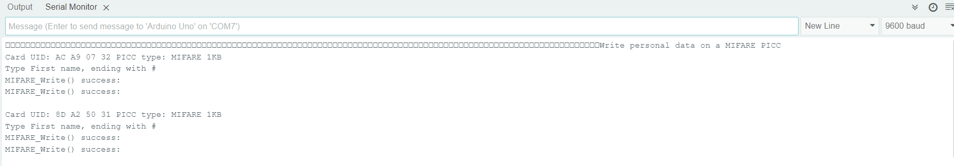
WRITE Information Program
Ass. Prof. Kunal D Gaikwad
CSE Department, CMRIT

